Slide 1

DevOps Project
Group: YAT224_CAI_SWD1_G6d
Team: DevOps
Group Members:
Amira Sherif
Sara Elsharkawy
Abdelrahman
Mariam
Mohamed Khairy

Slide 2
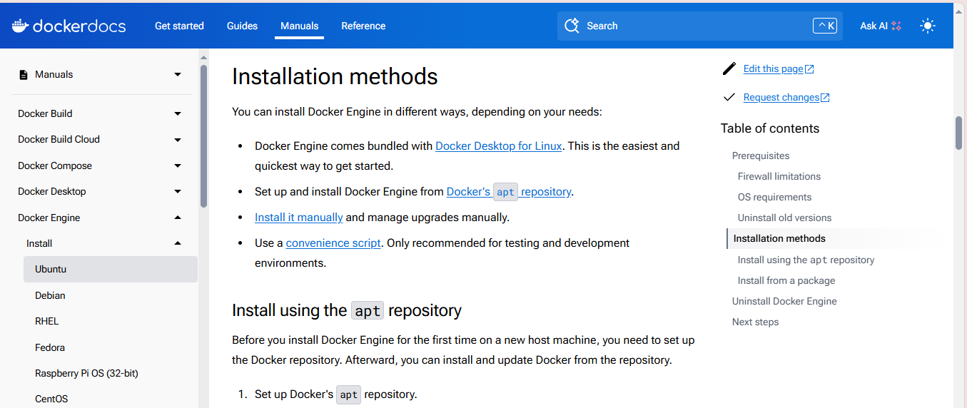
Install docker and Jenkins on local host

Slide 3
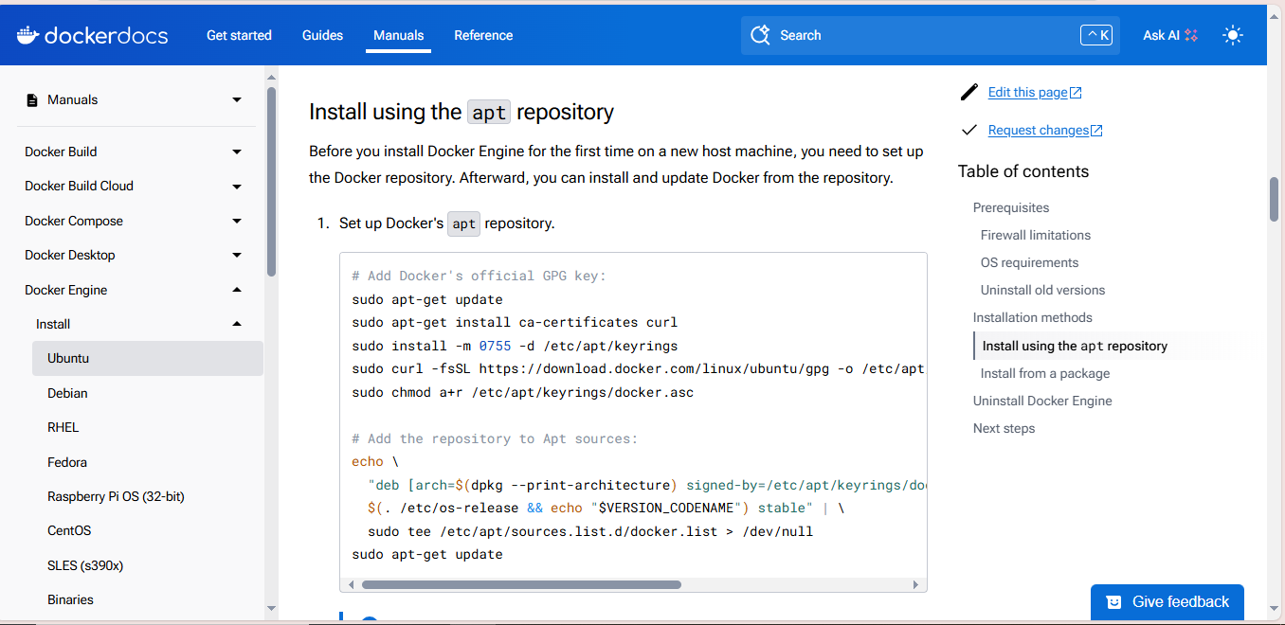

Slide 4
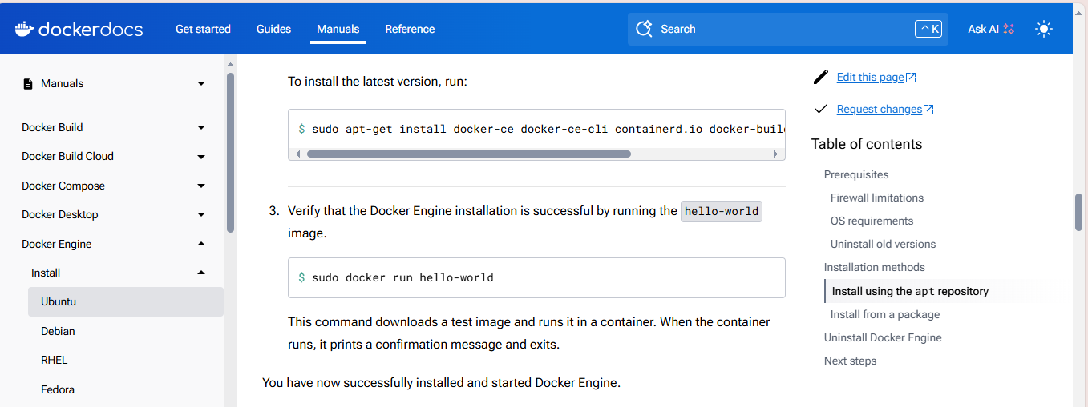

Slide 5
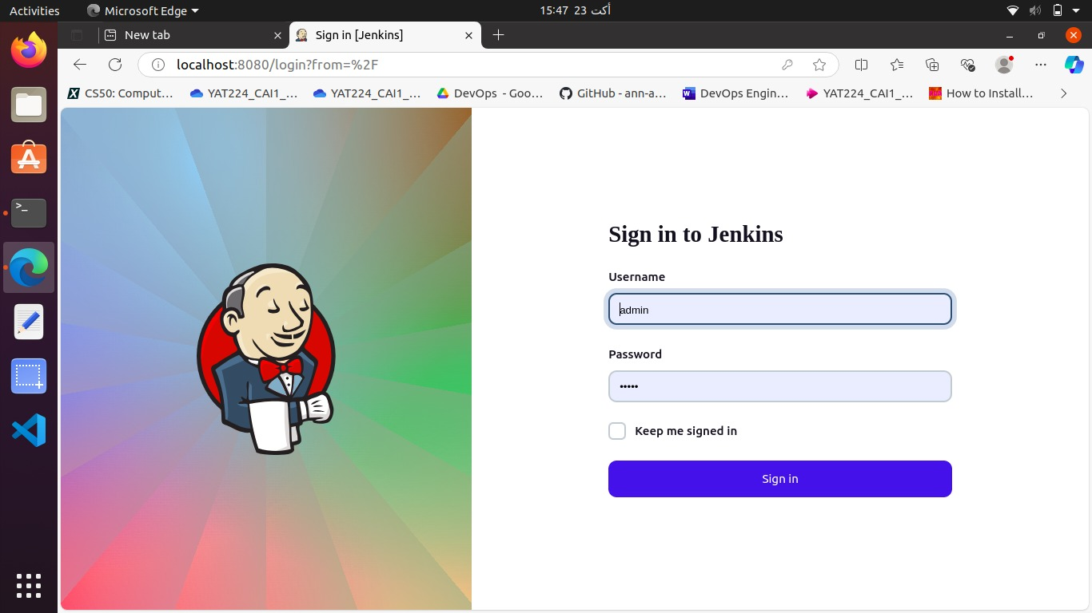
Install Jenkins on local host
docker run -d \
--name jenkins \
-p 8080:8080 \
-p 50000:50000 \
-v jenkins_home:/var/jenkins_home \
-v /var/run/docker.sock:/var/run/docker.sock \
jenkins/jenkins:lts

Slide 6
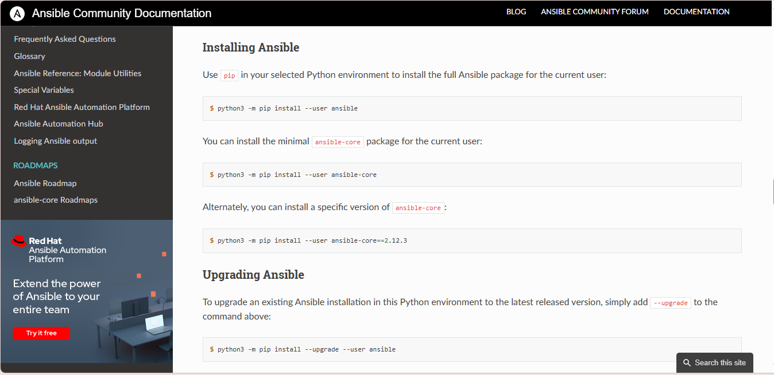
Install ansible for configuration

Slide 7
CI/CD Pipeline Plan :
1. Source Code Management
Repository: Use a version control system GitHub.
2. Triggering the Pipeline
Webhook: Set up a webhook to trigger the pipeline on code commits or pull requests.
3. Build Stage
Docker Build: Create a Docker image from the application code.
For deploying on AWS we used Ansible Playbook to install docker and run ansible.
4. Artifact Storage
Push to Registry: Store the Docker image in a container registry Docker Hub.
5. Notification Stage
Slack Notification: Send a Slack message to notify the team of the testing status (success or failure).
6. Deployment Stage
Deploy to Production: Use Ansible to deploy the Docker image to the production environment.
7. Monitoring and Feedback
Slack Notification: Send a Slack message to notify the team of the testing status (success or failure

Slide 8
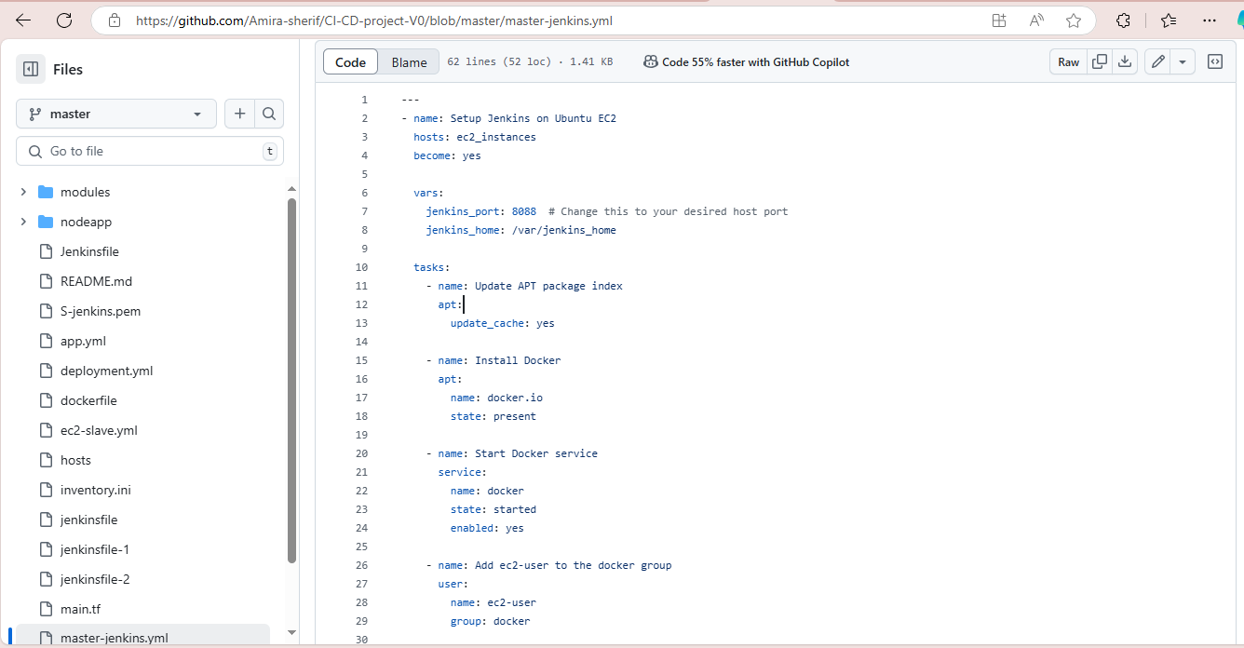
Implement Jenkins using ansible on AWS EC2

Slide 9
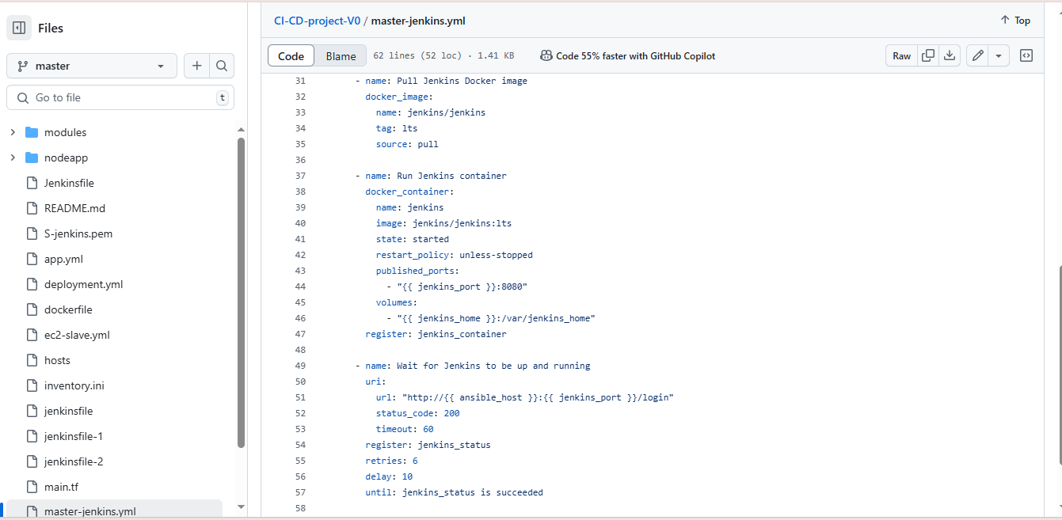
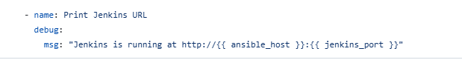

Slide 10
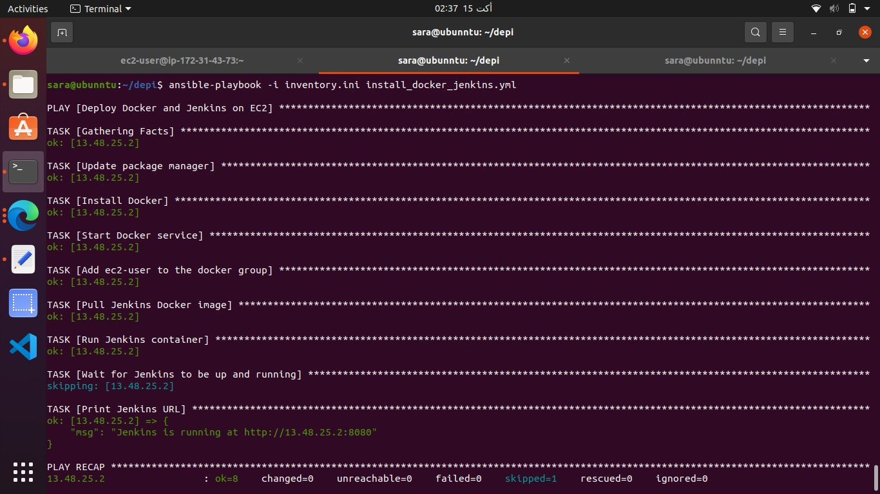

Slide 11
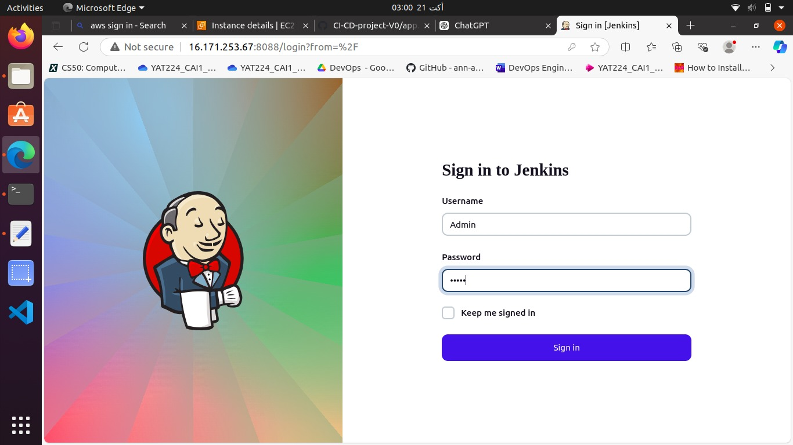

Slide 12
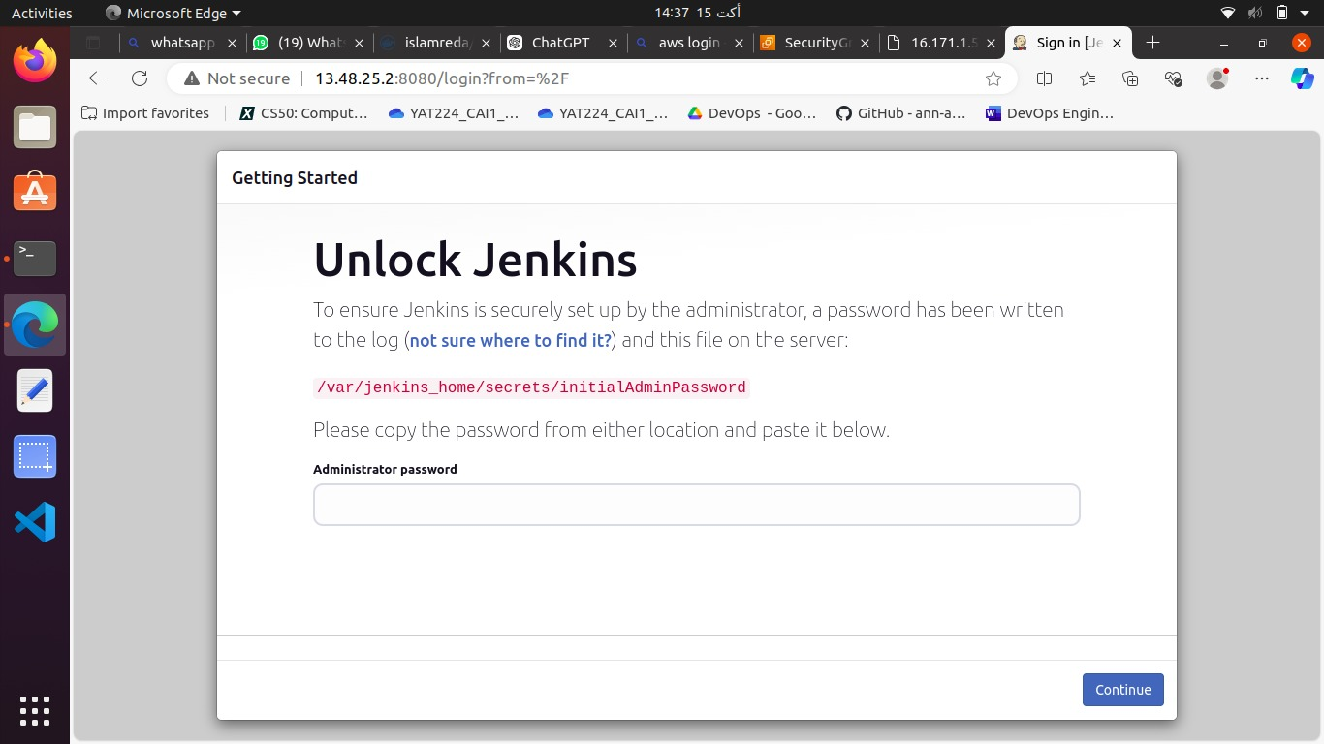

Slide 13
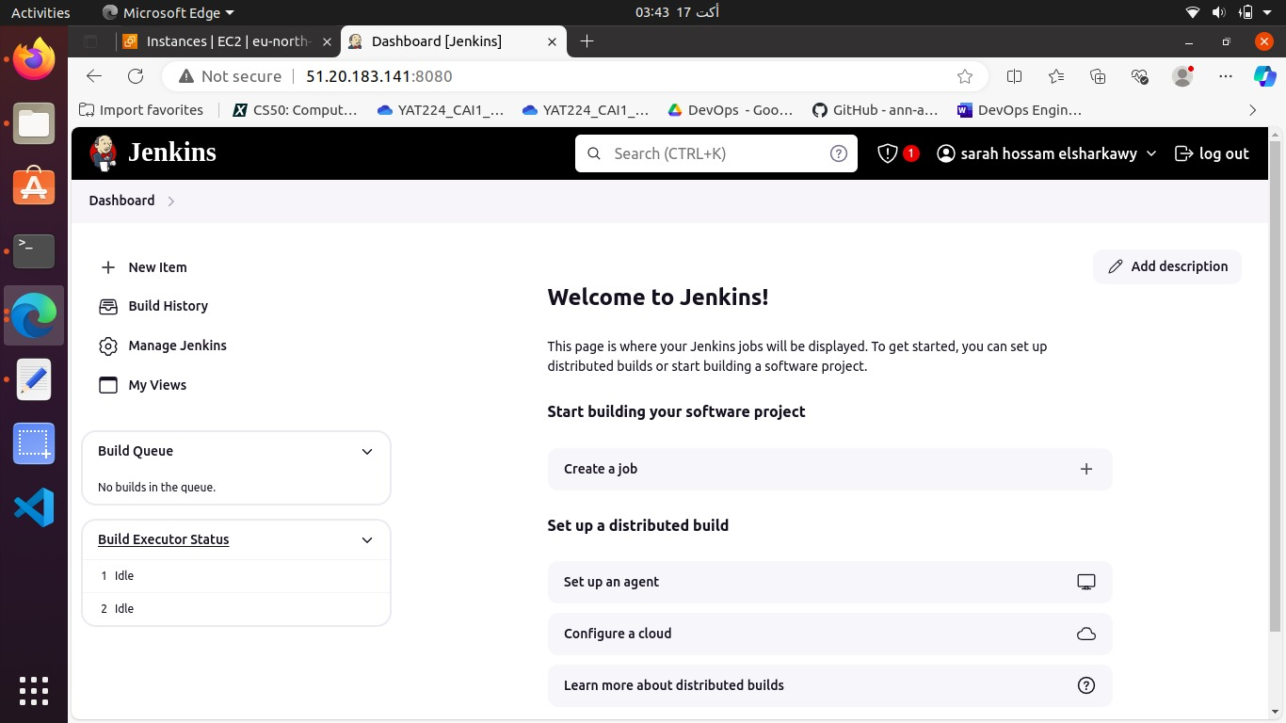

Slide 14
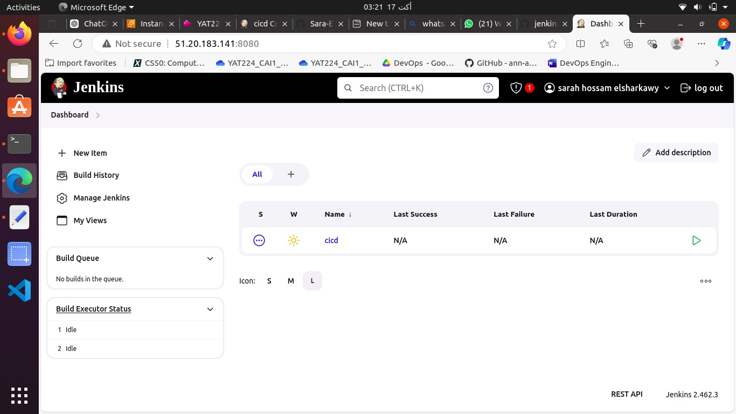

Slide 15
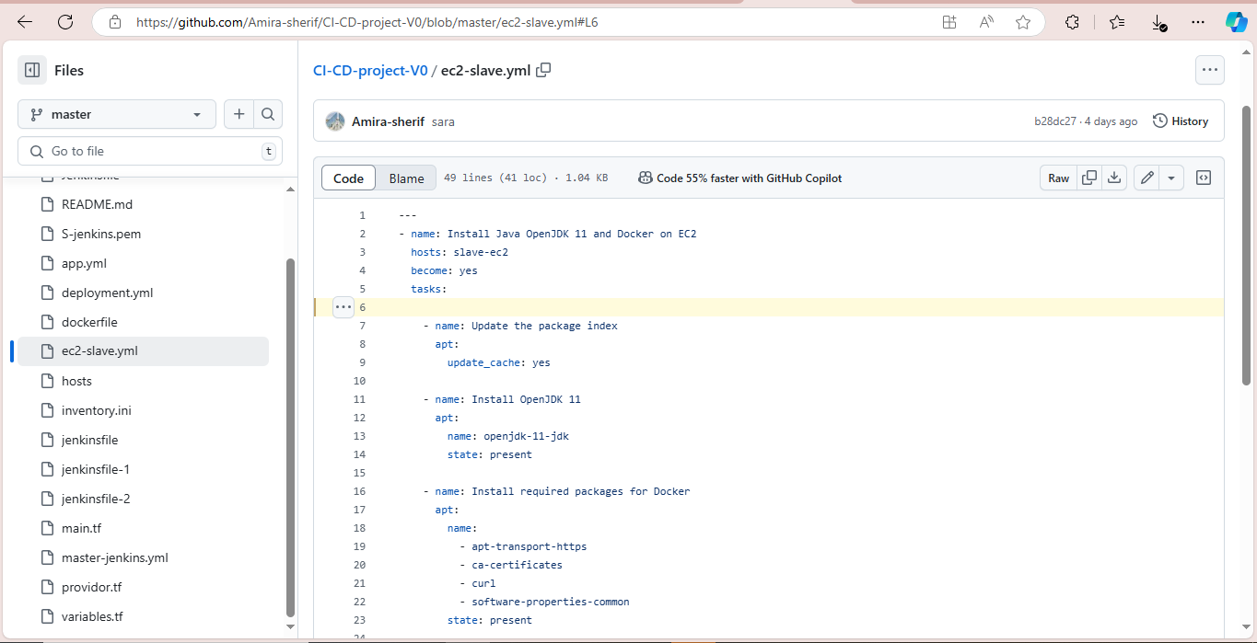
Create a playbook to set ec2 configuration to be ready as a Jenkins agent

Slide 16
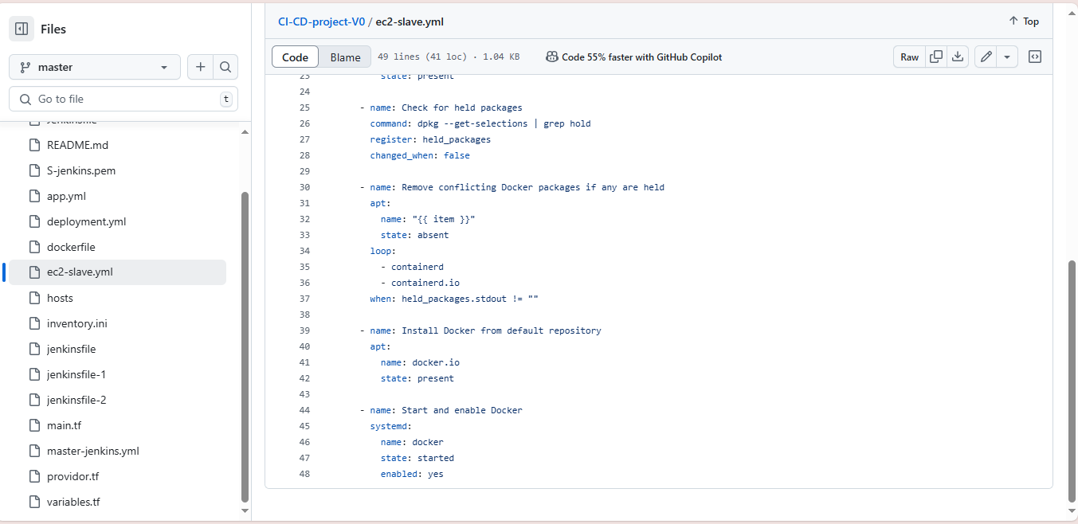

Slide 17
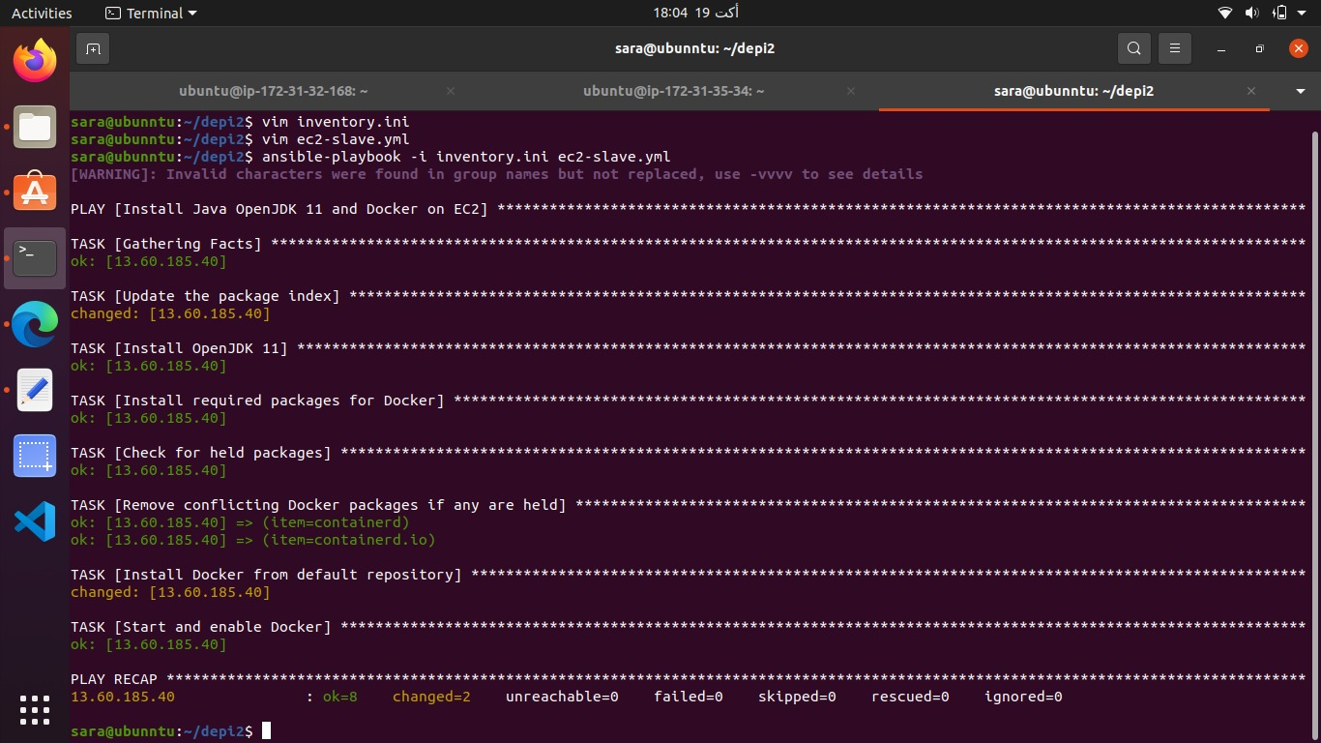

Slide 18
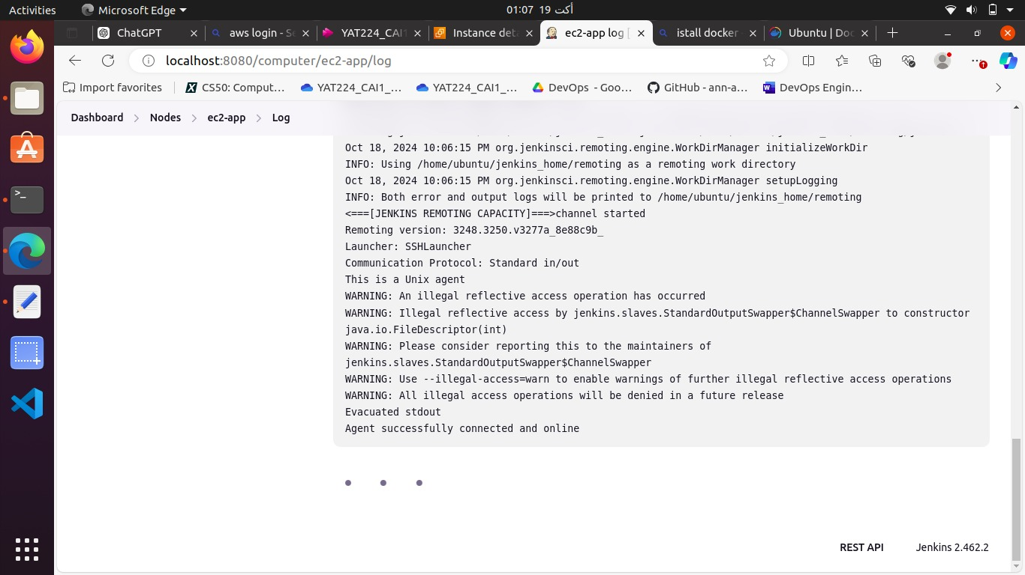
Create ec2 slave node for Jenkins

Slide 19
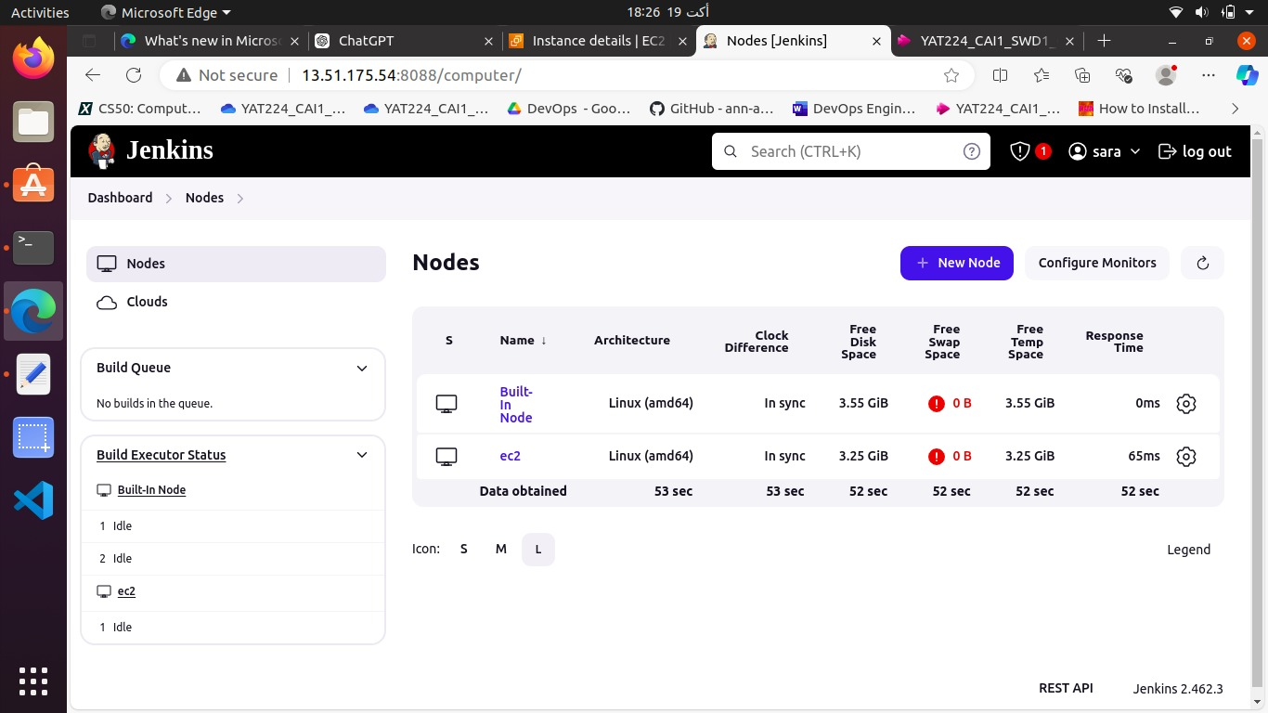

Slide 20
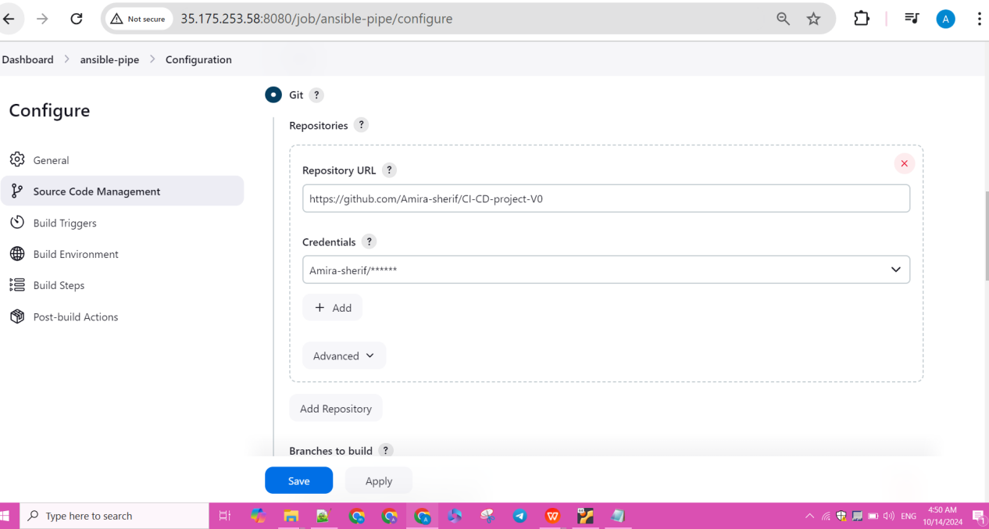
Git hub credential

Slide 21
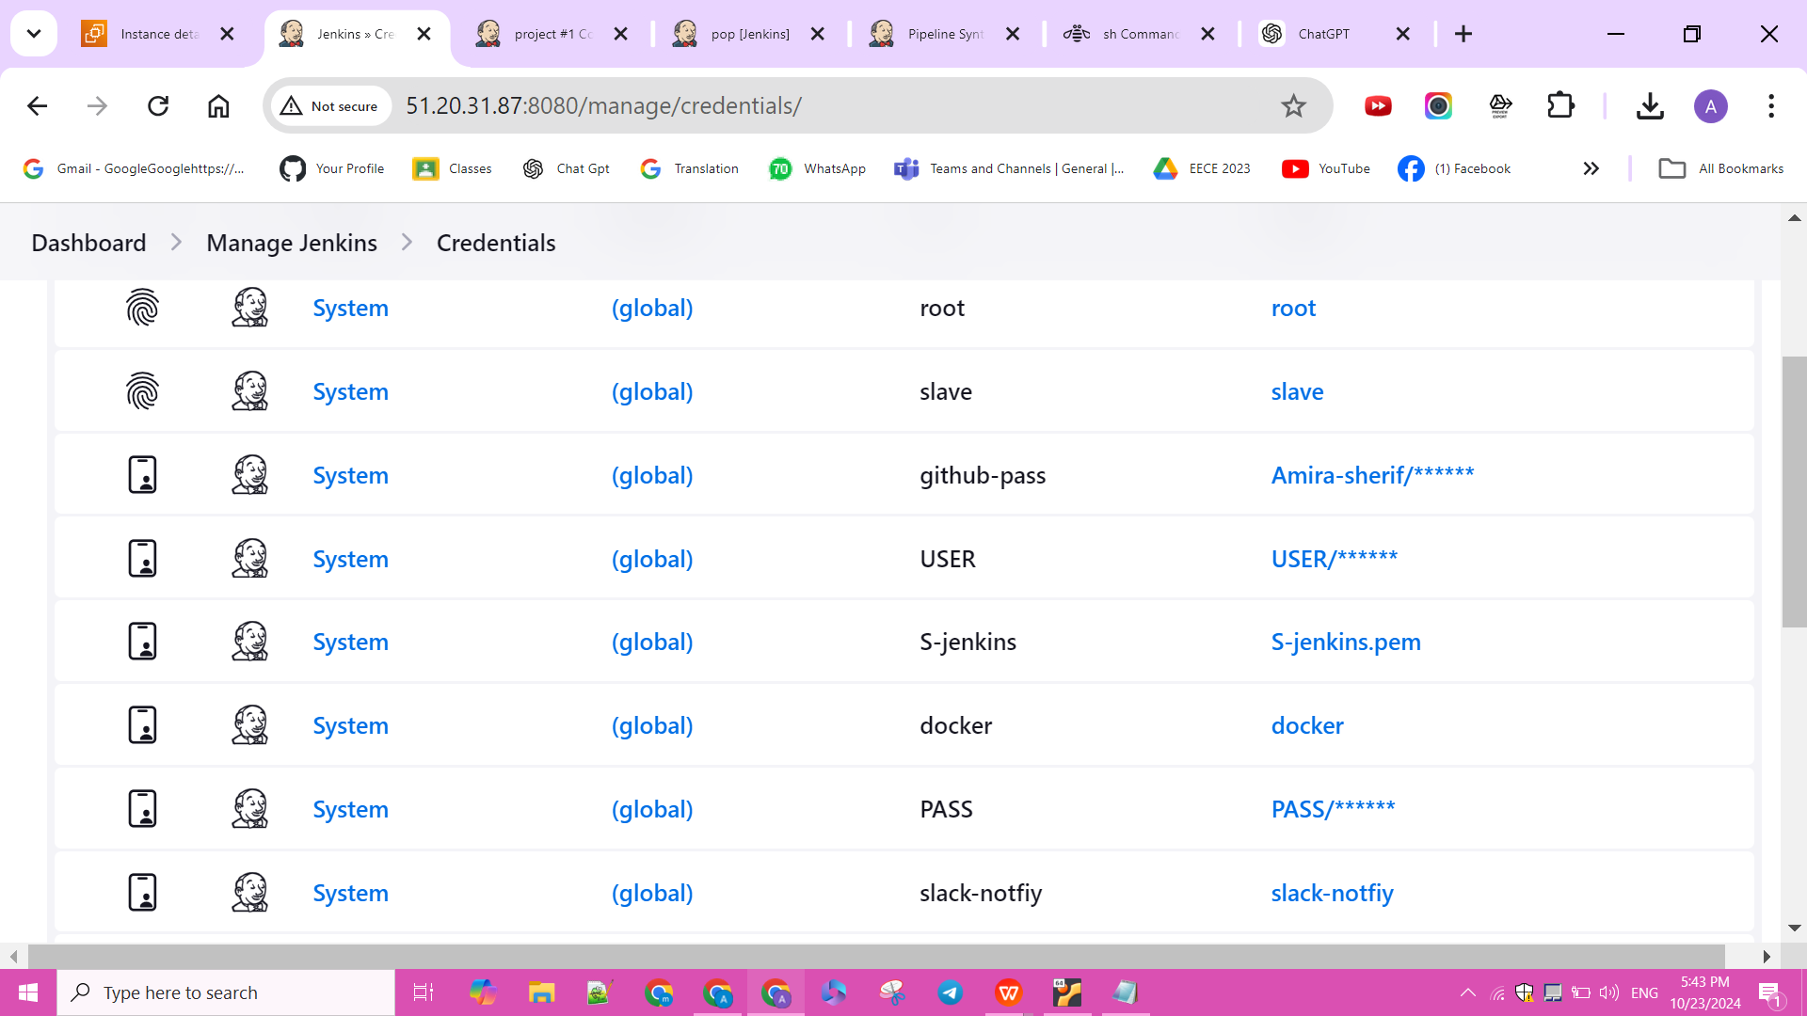
credentials

Slide 23
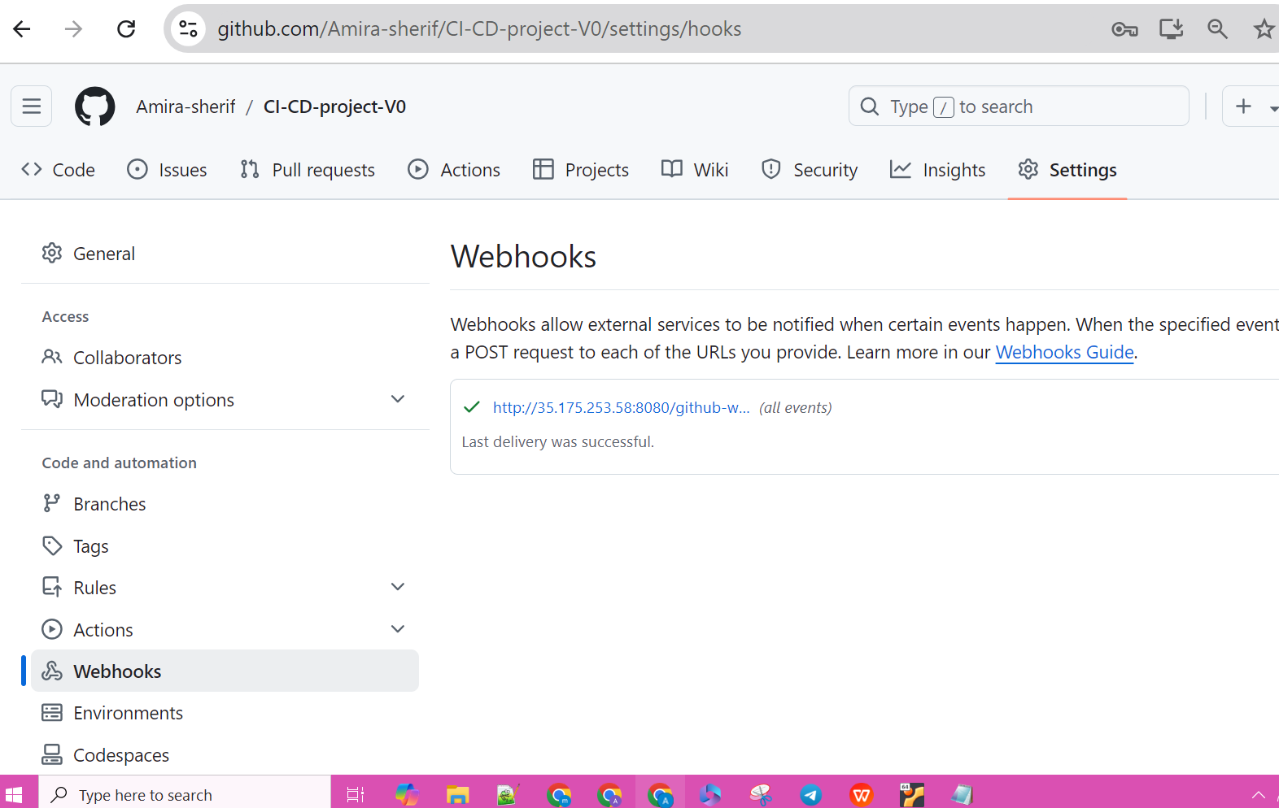
webhooks

Slide 24
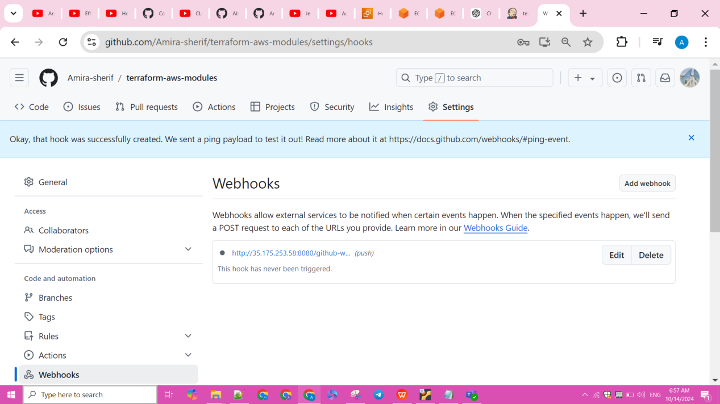
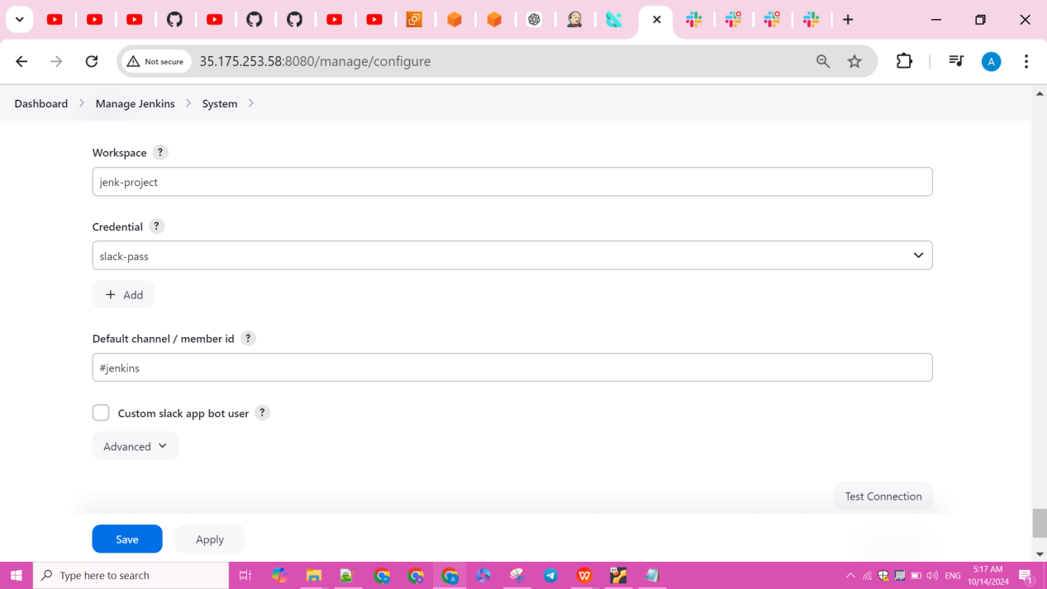

Slide 25
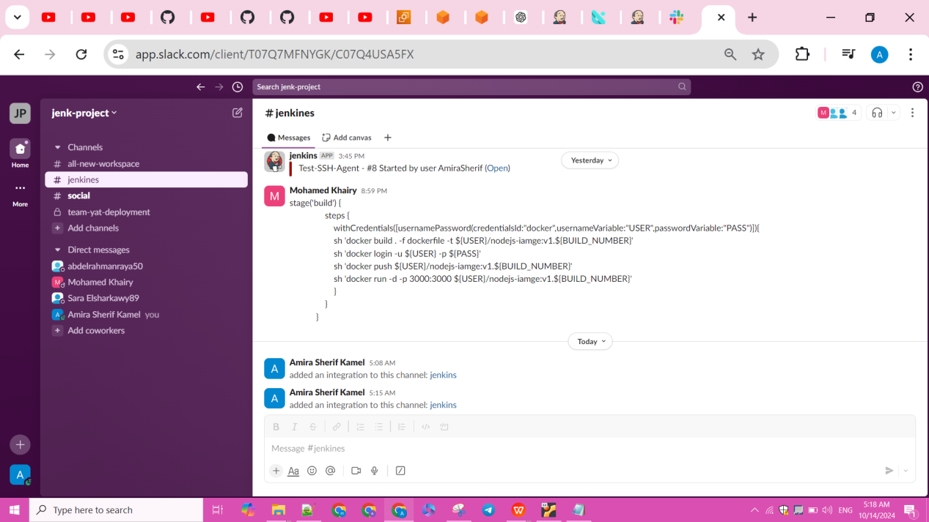
Set Up Notifications: Configure email/Slack notifications for pipeline success or failure.

Slide 26
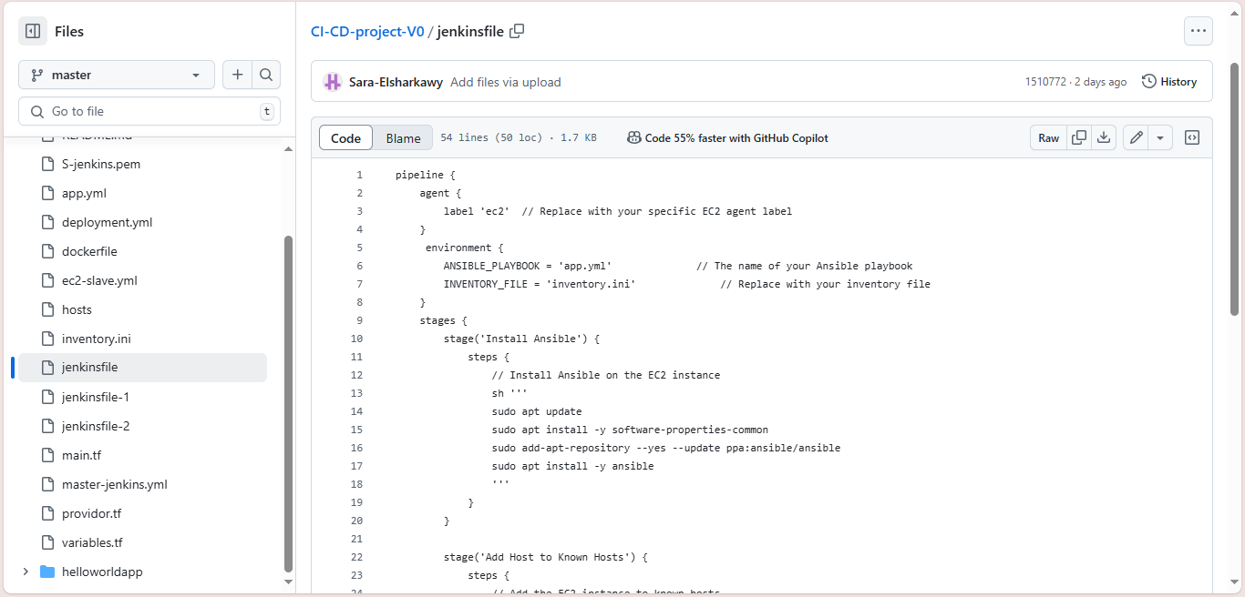
Pipeline

Slide 27
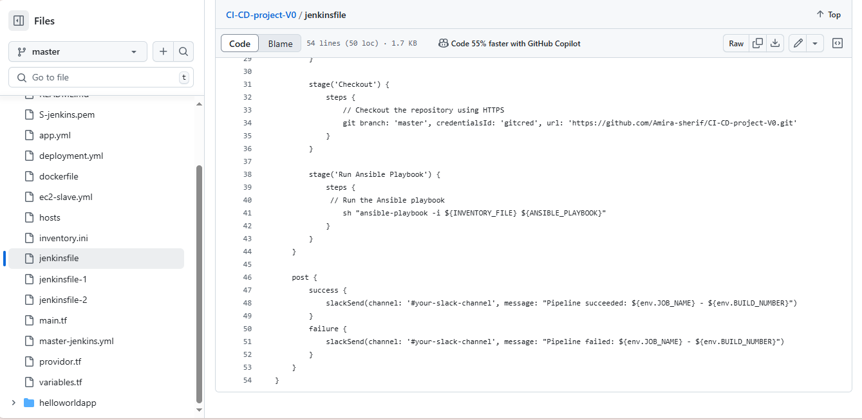
Pipeline

Slide 28
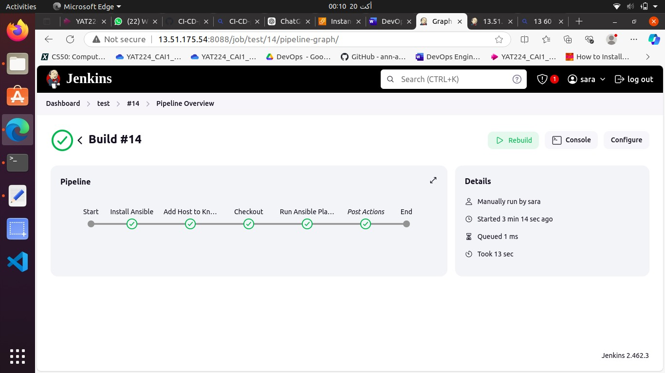
Pipeline

Slide 29
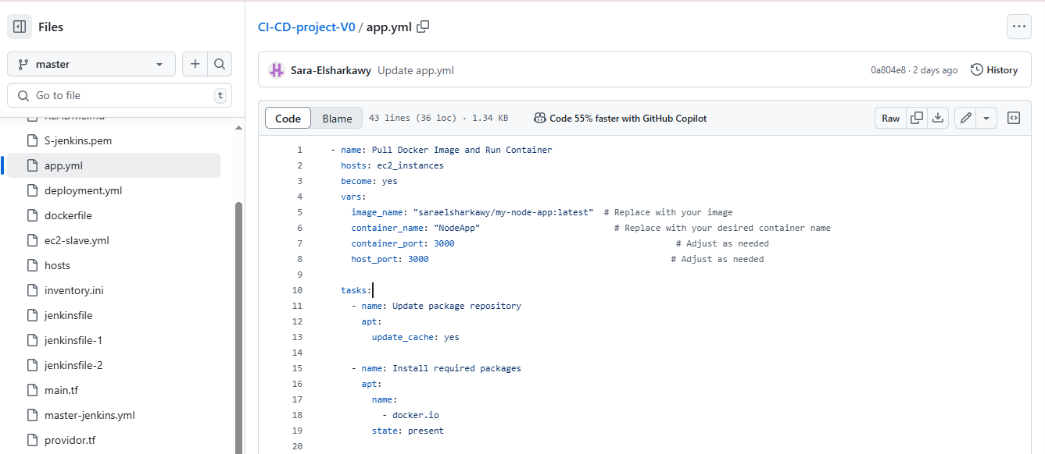
Playbook for the App

Slide 30
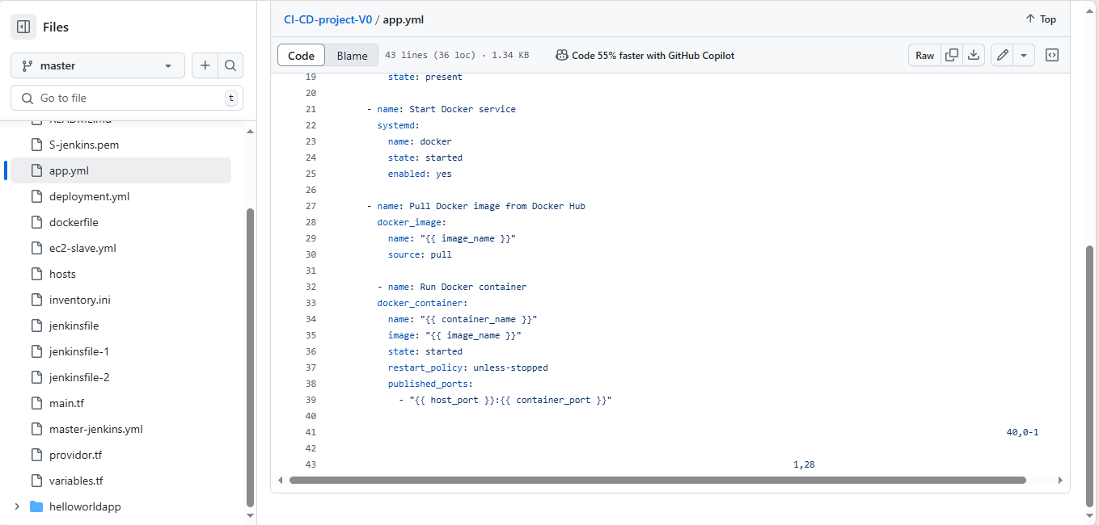

Slide 31
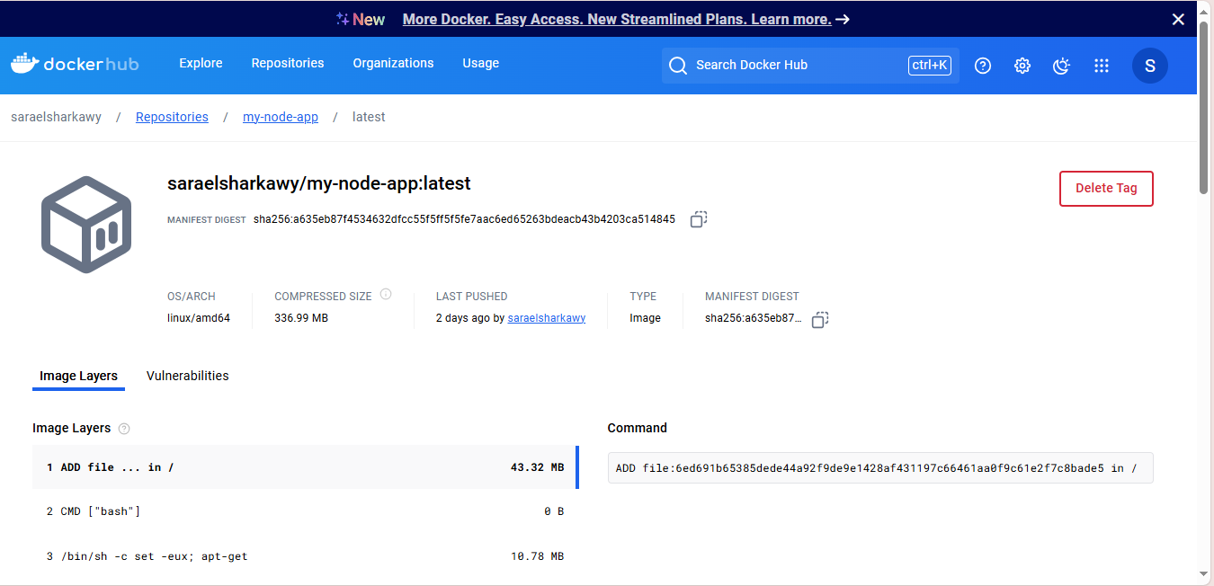

Slide 32
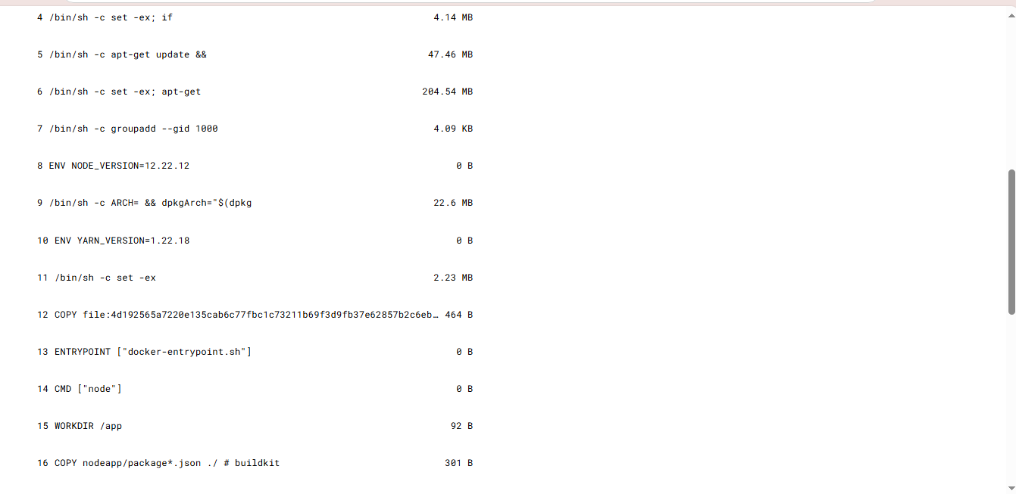

Slide 34
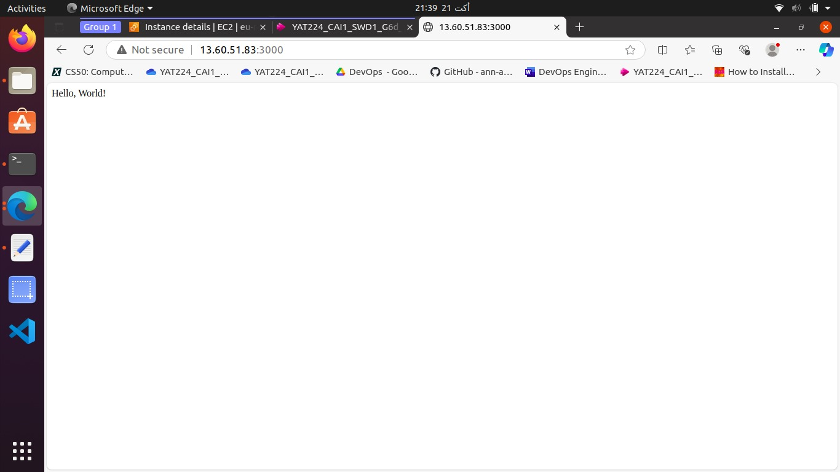
App running

Slide 35
Git URL
Amira-sherif/CI-CD-project-V0

